Slide 1
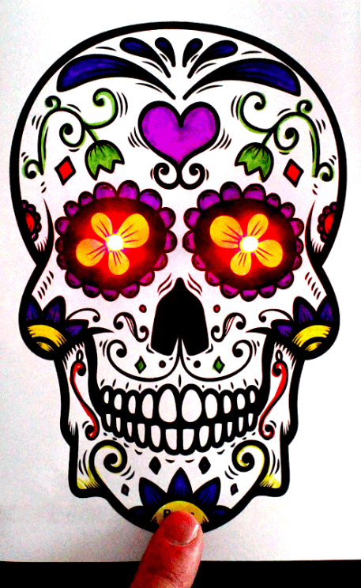
Day of The Dead or Dia De Los Muertos is celebrated in Mexico and Central America on November 1 and 2.
Sugar skulls represent a departed soul and are meant to honor the return of a particular spirit of a family member who has passed on.
Sugar skull art is a folk art style of big happy smiles, colorful icing and sparkly tin and glittery adornments.
Step 1 : Decorate with markers

Slide 2
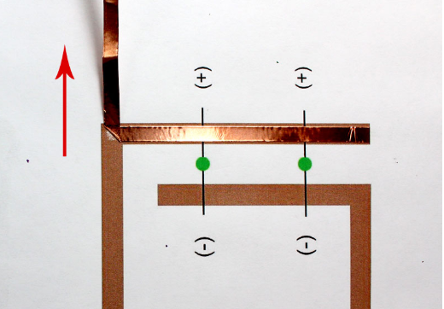
Step 2
Apply Copper Tape
Flip over your project template and apply your copper tape to all the brown lines.
Apply the copper in a single piece.
Do NOT cut it at the corners.
Apply the copper tape in a straight line and then bend it up at a 45 degree angle.
Next, bend the copper tape straight down along the other brown line.

Slide 3
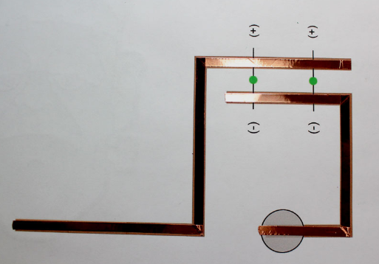
Step 3
Apply copper to the other brown lines
on the template and smooth it down
with your finger.
Open your card up and poke a hole with scissors in both of the eyes on the
skull template.
The LEDs will fit through these cuts.

Slide 4
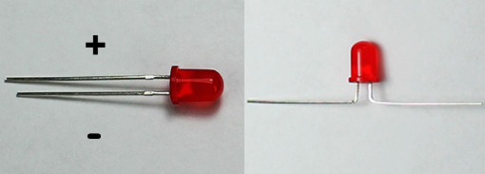
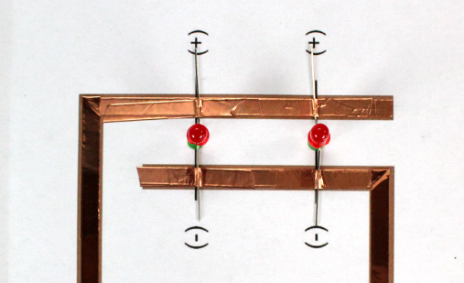
Step 4
Bend the LED legs and
tape to the template
Match the LED positive to positive and negative to negative on the template.
Tape the LEDs down

Slide 5

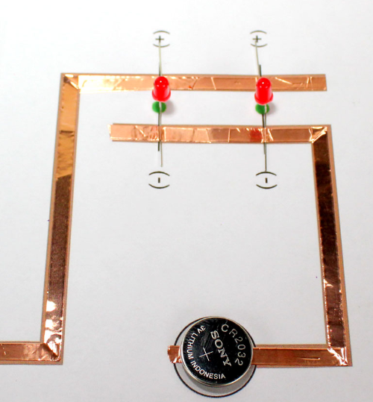
Step 5
Place a CR2032 battery on top
of the copper in the circle
with the negative (-) side
facing down.

Slide 6
Step 6
Test The Paper Circuit
The last step is the best part.
Close your card and
push the LEDs through the cuts
you made in the eyes.
Press the card to see your
creation come alive !

